Slide 1
Creating and Managing Tables
Notes:
Schedule: Timing Topic
30 minutes Lecture
20 minutes Practice
50 minutes Total

Slide 2
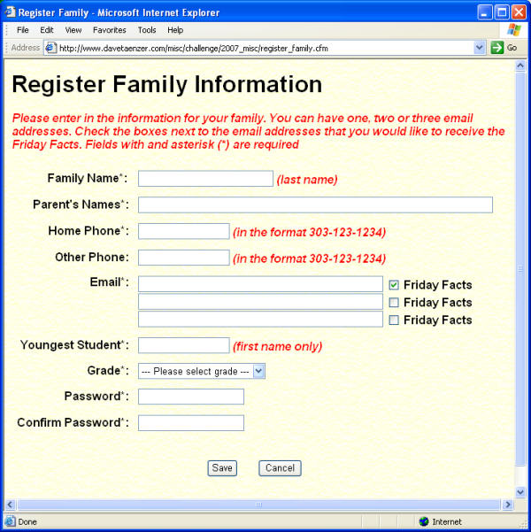

Slide 3
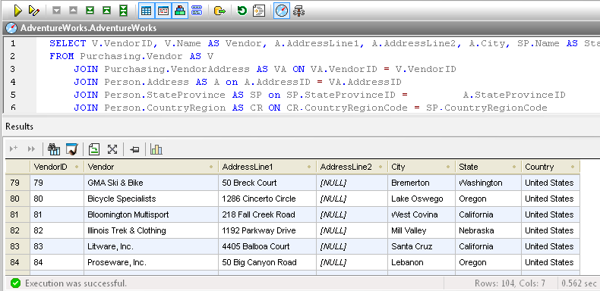

Slide 4
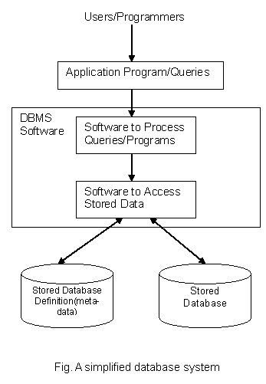
Database system

Slide 5
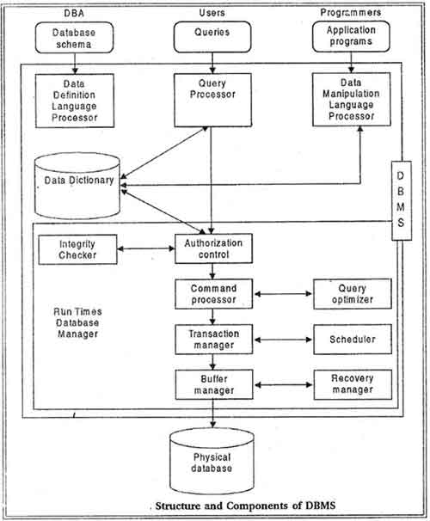

Slide 6
Querying
Language to interact with DBS
There are three parts
Data Definition Language (DDL)
Data Manipulation Language (DML)
Data Control Language (DCL)

Slide 7
Table: Naming Conventions
Must begin with a letter
Can be 1–30 characters long
Must contain only A–Z, a–z, 0–9, _, $, and #
Must not duplicate the name of another object owned by the same user
Must not be an Oracle Server reserved word
Notes:
Naming Rules
Name database tables and columns according to the standard rules for naming any Oracle database object:
Table names and column names must begin with a letter and can be 1–30 characters long.
Names must contain only the characters A–Z, a–z, 0–9, _ (underscore), $, and # (legal characters, but their use is discouraged).
Names must not duplicate the name of another object owned by the same Oracle Server user.
Names must not be an Oracle Server reserved word.
Naming Guidelines
Use descriptive names for tables and other database objects.
Name the same entity consistently in different tables. For example, the department number column is called DEPTNO in both the EMP table and the DEPT table.
Note: Names are case insensitive. For example, EMP is treated as the same name as eMP or eMp.
For more information, see Oracle Server SQL Reference, Release 8, “Object Names and Qualifiers.”

Slide 8
The CREATE TABLE Statement
You must have :
CREATE TABLE privilege
A storage area
You specify:
Table name
Column name, column datatype, and column size
CREATE TABLE [schema.]table
(column datatype [DEFAULT expr][, ...]);
Notes:
The CREATE TABLE Statement
Create tables to store data by executing the SQL CREATE TABLE statement. This statement is one of the data definition language (DDL) statements, which are covered in subsequent lessons. DDL statements are a subset of SQL statements used to create, modify, or remove Oracle8 database structures. These statements have an immediate effect on the database, and they also record information in the data dictionary.
To create a table, a user must have the CREATE TABLE privilege and a storage area in which to create objects. The database administrator uses data control language (DCL) statements, which are covered in a later lesson, to grant privileges to users.
In the syntax:
schema is the same as the owner’s name
table is the name of the table
DEFAULT expr specifies a default value if a value is omitted in the INSERT statement
column is the name of the column
datatype is the column’s datatype and length
For more information, see Oracle Server SQL Reference, Release 8, “CREATE TABLE.”

Slide 9
Creating Tables
Create the table.
SQL> CREATE TABLE dept 2 (deptno NUMBER(2),
3 dname VARCHAR2(14),
4 loc VARCHAR2(13));
Table created.
Confirm table creation.
SQL> DESCRIBE dept
Name Null? Type
--------------------------- -------- ---------
DEPTNO NUMBER(2)
DNAME VARCHAR2(14)
LOC VARCHAR2(13)
Notes:
Creating Tables
The example on the slide creates the DEPT table, with three columns—namely, DEPTNO, DNAME, and LOC. It further confirms the creation of the table by issuing the DESCRIBE command.
Since creating a table is a DDL statement, an automatic commit takes place when this statement is executed.

Slide 10
Data types
Datatype Description
VARCHAR2(size) Variable-length character data
CHAR(size) Fixed-length character data
NUMBER(p,s) Variable-length numeric data
DATE Date and time values
Notes:
Datatypes

Slide 11
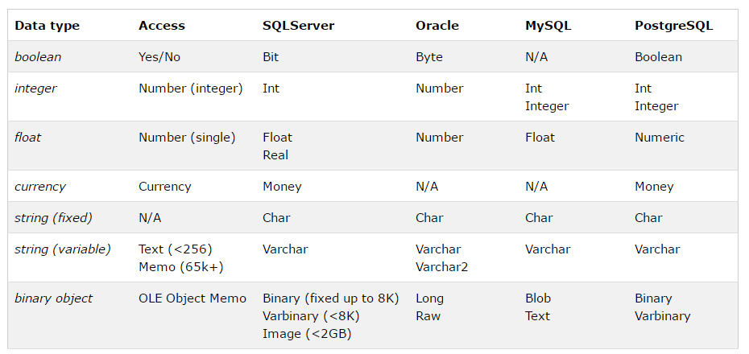

Slide 12
The ALTER TABLE Statement
Use the ALTER TABLE statement to:
Add a new column
Modify an existing column
Define a default value for the new column
ALTER TABLE table
ADD (column datatype [DEFAULT expr]
[, column datatype]...);
ALTER TABLE table
MODIFY (column datatype [DEFAULT expr]
[, column datatype]...);
Notes:
ALTER TABLE Statement
After you create your tables, you may need to change the table structures because you omitted a column or your column definition needs to be changed. You can do this by using the ALTER TABLE statement.
You can add columns to a table by using the ALTER TABLE statement with the ADD clause.
In the syntax:
table is the name of the table
column is the name of the new column
datatype is the datatype and length of the new column
DEFAULT expr specifies the default value for a new column
You can modify existing columns in a table by using the ALTER TABLE statement with the MODIFY clause.
Note: The slide gives the abridged syntax for ALTER TABLE. More about ALTER TABLE is covered in a subsequent lesson.

Slide 13
Adding a Column
“…add a new column into DEPT30 table…”
DEPT30
New column
EMPNO ENAME ANNSAL HIREDATE
------ ---------- --------
7698 BLAKE 34200 01-MAY-81
7654 MARTIN 15000 28-SEP-81
7499 ALLEN 19200 20-FEB-81
7844 TURNER 18000 08-SEP-81
...
JOB
DEPT30
EMPNO ENAME ANNSAL HIREDATE
------ ---------- --------
7698 BLAKE 34200 01-MAY-81
7654 MARTIN 15000 28-SEP-81
7499 ALLEN 19200 20-FEB-81
7844 TURNER 18000 08-SEP-81
...
JOB
Notes:
Adding a Column
The graphic adds the JOB column to DEPT30 table. Notice that the new column becomes the last column in the table.

Slide 14
Adding a Column
You use the ADD clause to add columns.
SQL> ALTER TABLE dept30
2 ADD (job VARCHAR2(9));
Table altered.
The new column becomes the last column.
EMPNO ENAME ANNSAL HIREDATE JOB
--------- ---------- --------- --------- ----
7698 BLAKE 34200 01-MAY-81
7654 MARTIN 15000 28-SEP-81
7499 ALLEN 19200 20-FEB-81
7844 TURNER 18000 08-SEP-81
...
6 rows selected.
Notes:
Guidelines for Adding a Column
You can add or modify columns, but you cannot drop them from a table.
You cannot specify where the column is to appear. The new column becomes the last column.
The example on the slide adds a column named JOB to the DEPT30 table. The JOB column becomes the last column in the table.
Note: If a table already contains rows when a column is added, then the new column is initially null for all the rows.
Class Management Note
Oracle8i provides new options for the ALTER TABLE command, including the ability to drop a column from a table.

Slide 15
Modifying a Column
You can change a column’s data type, size, and default value.
A change to the default value affects only subsequent insertions to the table.
ALTER TABLE dept30
MODIFY (ename VARCHAR2(15));
Table altered.
Notes:
Modifying a Column
You can modify a column definition by using the ALTER TABLE statement with the MODIFY clause. Column modification can include changes to a column’s datatype, size, and default value.
Guidelines
Increase the width or precision of a numeric column.
Decrease the width of a column if the column contains only null values or if the table has no rows.
Change the datatype if the column contains null values.
Convert a CHAR column to the VARCHAR2 datatype or convert a VARCHAR2 column to the CHAR datatype if the column contains null values or if you do not change the size.
A change to the default value of a column affects only subsequent insertions to the table.

Slide 16
Dropping a Table
All data and structure in the table is deleted.
Any pending transactions are committed.
All indexes are dropped.
You cannot roll back this statement.
SQL> DROP TABLE dept30;
Table dropped.
Notes:
Dropping a Table
The DROP TABLE statement removes the definition of an Oracle8 table. When you drop a table, the database loses all the data in the table and all the indexes associated with it.
Syntax
where: table is the name of the table
Guidelines
All data is deleted from the table.
Any views and synonyms will remain but are invalid.
Any pending transactions are committed.
Only the creator of the table or a user with the DROP ANY TABLE privilege can remove a table.
The DROP TABLE statement, once executed, is irreversible. The Oracle Server does not question the action when you issue the DROP TABLE statement. If you own that table or have a high-level privilege, then the table is immediately removed. All DDL statements issue a commit, therefore making the transaction permanent.
DROP TABLE table;

Slide 17
Changing the Name of an Object
To change the name of a table, view, sequence, or synonym, you execute the RENAME statement.
You must be the owner of the object.
SQL> RENAME dept TO department;
Table renamed.
Notes:
Renaming a Table
Additional DDL statements include the RENAME statement, which is used to rename a table, view, sequence, or a synonym.
Syntax
RENAME old_name TO new_name;
where: old_name is the old name of the table, view, sequence, or synonym
new_name is the new name of the table, view, sequence, or synonym
You must be the owner of the object that you rename.

Slide 18
Truncating a Table
The TRUNCATE TABLE statement:
Removes all rows from a table
Releases the storage space used by that table
You cannot roll back row removal when using TRUNCATE.
Alternatively, you can remove rows by using the DELETE statement.
SQL> TRUNCATE TABLE department;
Table truncated.
Notes:
Truncating a Table
Another DDL statement is the TRUNCATE TABLE statement, which is used to remove all rows from a table and to release the storage space used by that table. When using the TRUNCATE TABLE statement, you cannot rollback row removal.
Syntax
TRUNCATE TABLE table;
where: table is the name of the table
You must be the owner of the table or have DELETE TABLE system privileges to truncate a table.
The DELETE statement can also remove all rows from a table, but it does not release storage space.

Slide 19
Summary
Statement Description
CREATE TABLE Creates a table
ALTER TABLE Modifies table structures
DROP TABLE Removes the rows and table structure
RENAME Changes the name of a table, view, sequence, or synonym
TRUNCATE Removes all rows from a table and releases the storage space
Notes:
CREATE TABLE
Create a table.
Create a table based on another table by using a subquery.
ALTER TABLE
Modify table structures.
Change column widths, change column datatypes, and add columns.
DROP TABLE
Remove rows and a table structure.
Once executed, this statement cannot be rolled back.
RENAME
Rename a table, view, sequence, or synonym.
TRUNCATE
Remove all rows from a table and release the storage space used by the table.
The DELETE statement removes only rows.
COMMENT
Add a comment to a table or a column.
Query the data dictionary to view the comment.

Slide 20
Including Constraints
Notes:
Schedule: Timing Topic
45 minutes Lecture
25 minutes Practice
70 minutes Total

Slide 21
Objectives
After completing this lesson, you should be able to do the following:
Describe constraints
Create and maintain constraints
Some Constraints were done at Design Time
Some at Implementation time
Notes:
Lesson Aim
In this lesson, you will learn how to implement business rules by including integrity constraints.

Slide 22
What Are Constraints?
Constraints enforce rules at the table level.
Constraints prevent the deletion of a table if there are dependencies.
The following constraint types are valid in Oracle:
NOT NULL
UNIQUE
PRIMARY KEY
FOREIGN KEY
CHECK
Notes:
Constraints
The Oracle Server uses constraints to prevent invalid data entry into tables.
You can use constraints to do the following:
Enforce rules at the table level whenever a row is inserted, updated, or deleted from that table. The constraint must be satisfied for the operation to succeed.
Prevent the deletion of a table if there are dependencies from other tables.
Provide rules for Oracle tools, such as Oracle Developer.
Data Integrity Constraints
For more information, see Oracle Server SQL Reference, Release 8, “CONSTRAINT Clause.”

Slide 23
Constraint Guidelines
Name a constraint or the Oracle Server will generate a name by using the SYS_Cn format.
Create a constraint:
At the same time as the table is created
After the table has been created
Define a constraint at the column or table level.
View a constraint in the data dictionary.
Notes:
Constraint Guidelines
All constraints are stored in the data dictionary. Constraints are easy to reference if you give them a meaningful name. Constraint names must follow the standard object-naming rules. If you do not name your constraint, Oracle generates a name with the format SYS_Cn, where n is an integer to create a unique constraint name.
Constraints can be defined at the time of table creation or after the table has been created.
You can view the constraints defined for a specific table by looking at the USER_CONSTRAINTS data dictionary table.

Slide 24
Defining Constraints
CREATE TABLE [schema.]table
(column datatype [DEFAULT expr]
[column_constraint],
...
[table_constraint][,...]);
CREATE TABLE emp(
empno NUMBER(4),
ename VARCHAR2(10),
...
deptno NUMBER(7,2) NOT NULL,
CONSTRAINT emp_empno_pk
PRIMARY KEY (EMPNO));
Notes:
Defining Constraints
The slide gives the syntax for defining constraints while creating a table.
In the syntax:
schema is the same as the owner’s name
table is the name of the table
DEFAULT expr specifies a default value if a value is omitted in the INSERT statement
column is the name of the column
datatype is the column’s datatype and length
column_constraint is an integrity constraint as part of the column definition
table_constraint is an integrity constraint as part of the table definition
For more information, see Oracle Server SQL Reference, Release 8, “CREATE TABLE.”

Slide 25
Defining Constraints
Column constraint level
Table constraint level
column [CONSTRAINT constraint_name] constraint_type,
column,...
[CONSTRAINT constraint_name] constraint_type
(column, ...),
Notes:
Defining Constraints (continued)
Constraints are usually created at the same time as the table. Constraints can be added to a table after its creation and also temporarily disabled.
Constraints can be defined at one of two levels.
In the syntax:
constraint_name is the name of the constraint
constraint_type is the type of the constraint
Class Management Note
Explain that the column level and the table level refer to location in the syntax.

Slide 26
The NOT NULL Constraint
Ensures that null values are not permitted for the column
EMP
EMPNO ENAME JOB ... COMM DEPTNO
7839 KING PRESIDENT 10
7698 BLAKE MANAGER 30
7782 CLARK MANAGER 10
7566 JONES MANAGER 20
...
NOT NULL constraint
(no row can contain a null value for this column)
Absence of NOT NULL constraint
(any row can contain null for this column)
NOT NULL constraint
Notes:
The NOT NULL Constraint
The NOT NULL constraint ensures that null values are not allowed in the column. Columns without the NOT NULL constraint can contain null values by default.

Slide 27
The NOT NULL Constraint
Defined at the column level
SQL> CREATE TABLE emp(
2 empno NUMBER(4),
3 ename VARCHAR2(10) NOT NULL,
4 job VARCHAR2(9),
5 mgr NUMBER(4),
6 hiredate DATE,
7 sal NUMBER(7,2),
8 comm NUMBER(7,2),
9 deptno NUMBER(7,2) NOT NULL);
Notes:
The NOT NULL Constraint (continued)
The NOT NULL constraint can be specified only at the column level, not at the table level.
The slide example applies the NOT NULL constraint to the ENAME and DEPTNO columns of the EMP table. Because these constraints are unnamed, the Oracle Server will create names for them.
You can specify the name of the constraint while specifying the constraint.
Note: All the constraint examples described in this lesson may not be present in the sample tables provided with the course. If desired, these constraints can be added to the tables.
... deptno NUMBER(7,2)
CONSTRAINT emp_deptno_nn NOT NULL...

Slide 28
The UNIQUE Key Constraint
UNIQUE key constraint
DEPT
DEPTNO DNAME LOC
------ ---------- --------
10 ACCOUNTING NEW YORK
20 RESEARCH DALLAS
30 SALES CHICAGO
40 OPERATIONS BOSTON
Insert into
Not allowed (DNAME−SALES already exists)
50 SALES DETROIT
60 BOSTON
Allowed
Notes:
The UNIQUE Key Constraint
A UNIQUE key integrity constraint requires that every value in a column or set of columns (key) be unique—that is, no two rows of a table have duplicate values in a specified column or set of columns. The column (or set of columns) included in the definition of the UNIQUE key constraint is called the unique key. If the UNIQUE key comprises more than one column, that group of columns is said to be a composite unique key.
UNIQUE key constraints allow the input of nulls unless you also define NOT NULL constraints for the same columns. In fact, any number of rows can include nulls for columns without NOT NULL constraints because nulls are not considered equal to anything. A null in a column (or in all columns of a composite UNIQUE key) always satisfies a UNIQUE key constraint.
Note: Because of the search mechanism for UNIQUE constraints on more than one column, you cannot have identical values in the non-null columns of a partially null composite UNIQUE key constraint.
Class Management Note
Explain to students that since SALES department already exists, the first entry is not allowed. In the second entry, the department name is null; this entry is allowed.

Slide 29
The UNIQUE Key Constraint
Defined at either the table level or the column level
SQL> CREATE TABLE dept(
2 deptno NUMBER(2),
3 dname VARCHAR2(14),
4 loc VARCHAR2(13),
5 CONSTRAINT dept_dname_uk UNIQUE(dname));
Notes:
The UNIQUE Key Constraint (continued)
UNIQUE key constraints can be defined at the column or table level. A composite unique key is created by using the table level definition.
The example on the slide applies UNIQUE key constraint to the DNAME column of the DEPT table. The name of the constraint is DEPT_DNAME_UK.
Note: The Oracle Server enforces the UNIQUE key constraint by implicitly creating a unique index on the unique key.

Slide 30
The PRIMARY KEY Constraint
PRIMARY KEY
DEPT
DEPTNO DNAME LOC
------ ---------- --------
10 ACCOUNTING NEW YORK
20 RESEARCH DALLAS
30 SALES CHICAGO
40 OPERATIONS BOSTON
Insert into
Not allowed (DEPTNO−20 already exists)
20 MARKETING DALLAS
FINANCE NEW YORK
Not allowed (DEPTNO is null)
Notes:
The PRIMARY KEY Constraint
A PRIMARY KEY constraint creates a primary key for the table. Only one primary key can be created for a each table. The PRIMARY KEY constraint is a column or set of columns that uniquely identifies each row in a table. This constraint enforces uniqueness of the column or column combination and ensures that no column that is part of the primary key can contain a null value.

Slide 31
The PRIMARY KEY Constraint
Defined at either the table level or the column level
SQL> CREATE TABLE dept(
2 deptno NUMBER(2),
3 dname VARCHAR2(14),
4 loc VARCHAR2(13),
5 CONSTRAINT dept_dname_uk UNIQUE (dname),
6 CONSTRAINT dept_deptno_pk PRIMARY KEY(deptno));
Notes:
The PRIMARY KEY Constraint (continued)
PRIMARY KEY constraints can be defined at the column level or table level. A composite PRIMARY KEY is created by using the table level definition.
The example on the slide defines a PRIMARY KEY constraint on the DEPTNO column of the DEPT table. The name of the constraint is DEPT_DEPTNO_PK.
Note: A UNIQUE index is automatically created for a PRIMARY KEY column.

Slide 32
The FOREIGN KEY Constraint
DEPT
PRIMARY KEY
DEPTNO DNAME LOC
------ ---------- --------
10 ACCOUNTING NEW YORK
20 RESEARCH DALLAS
...
EMP
EMPNO ENAME JOB ... COMM DEPTNO
7839 KING PRESIDENT 10
7698 BLAKE MANAGER 30
...
FOREIGN KEY
Not allowed (DEPTNO 9 does not exist in the DEPT table)
7571 FORD MANAGER ... 200 9
7571 FORD MANAGER ... 200 20
Insert into
Allowed
Notes:
The FOREIGN KEY Constraint
The FOREIGN KEY, or referential integrity constraint, designates a column or combination of columns as a foreign key and establishes a relationship between a primary key or a unique key in the same table or a different table. In the example on the slide, DEPTNO has been defined as the foreign key in the EMP table (dependent or child table); it references the DEPTNO column of the DEPT table (referenced or parent table).
A foreign key value must match an existing value in the parent table or be NULL.
Foreign keys are based on data values and are purely logical, not physical, pointers.

Slide 33
The FOREIGN KEY Constraint
Defined at either the table level or the column level
SQL> CREATE TABLE emp(
2 empno NUMBER(4),
3 ename VARCHAR2(10) NOT NULL,
4 job VARCHAR2(9),
5 mgr NUMBER(4),
6 hiredate DATE,
7 sal NUMBER(7,2),
8 comm NUMBER(7,2),
9 deptno NUMBER(7,2) NOT NULL,
10 CONSTRAINT emp_deptno_fk FOREIGN KEY (deptno)
11 REFERENCES dept (deptno));
Notes:
The FOREIGN KEY Constraint (continued)
FOREIGN KEY constraints can be defined at the column or table constraint level. A composite foreign key must be created by using the table-level definition.
The example on the slide defines a FOREIGN KEY constraint on the DEPTNO column of the EMP table, using table level syntax. The name of the constraint is EMP_DEPTNO_FK.

Slide 34
FOREIGN KEY Constraint Keywords
FOREIGN KEY
Defines the column in the child table at the table constraint level
REFERENCES
Identifies the table and column in the parent table
ON DELETE CASCADE
Allows deletion in the parent table and deletion of the dependent rows in the child table
Notes:
The FOREIGN KEY Constraint (continued)
The foreign key is defined in the child table, and the table containing the referenced column is the parent table. The foreign key is defined using a combination of the following keywords:
FOREIGN KEY is used to define the column in the child table at the table constraint level.
REFERENCES identifies the table and column in the parent table.
ON DELETE CASCADE indicates that when the row in the parent table is deleted, the dependent rows in the child table will also be deleted.
Without the ON DELETE CASCADE option, the row in the parent table cannot be deleted if it is referenced in the child table.

Slide 35
The CHECK Constraint
Defines a condition that each row must satisfy
Expressions that are not allowed:
References to CURRVAL, NEXTVAL, LEVEL, and ROWNUM pseudocolumns
Calls to SYSDATE, UID, USER, and USERENV functions
Queries that refer to other values in other rows
..., deptno NUMBER(2),
CONSTRAINT emp_deptno_ck
CHECK (DEPTNO BETWEEN 10 AND 99),...
Notes:
The CHECK Constraint
The CHECK constraint defines a condition that each row must satisfy. The condition can use the same constructs as query conditions, with the following exceptions:
References to the CURRVAL, NEXTVAL, LEVEL, and ROWNUM pseudocolumns
Calls to SYSDATE, UID, USER, and USERENV functions
Queries that refer to other values in other rows
A single column can have multiple CHECK constraints that reference the column in its definition. There is no limit to the number of CHECK constraints that you can define on a column.
CHECK constraints can be defined at the column level or table level.
Class Management Note
You can defer checking constraints for validity until the end of the transaction.
A constraint is deferred if the system checks that it is satisfied only on commit. If a deferred constraint is violated, then commit causes the transaction to roll back.
A constraint is immediate if it is checked at the end of each statement. If it is violated, the statement is rolled back immediately.

Slide 36
Adding a Constraint
ALTER TABLE table
ADD [CONSTRAINT constraint] type (column);
Add or drop, but not modify, a constraint
Enable or disable constraints
Add a NOT NULL constraint by using the MODIFY clause
Notes:
Adding a Constraint
You can add a constraint for existing tables by using the ALTER TABLE statement with the ADD clause.
In the syntax:
table is the name of the table
constraint is the name of the constraint
type is the constraint type
column is the name of the column affected by the constraint
The constraint name syntax is optional, although recommended. If you do not name your constraints, the system will generate constraint names.
Guidelines:
You can add, drop, enable, or disable a constraint, but you cannot modify its structure.
You can add a NOT NULL constraint to an existing column by using the MODIFY clause of the ALTER TABLE statement.
Note: You can define a NOT NULL column only if the table contains no rows, because data cannot be specified for existing rows at the same time that the column is added.

Slide 37
Adding a Constraint
Add a FOREIGN KEY constraint to the EMP table indicating that a manager must already exist as a valid employee in the EMP table.
SQL> ALTER TABLE emp
2 ADD CONSTRAINT emp_mgr_fk
3 FOREIGN KEY(mgr) REFERENCES emp(empno);
Table altered.
Notes:
Adding a Constraint (continued)
The example on the slide creates a FOREIGN KEY constraint on the EMP table. The constraint ensures that a manager exists as a valid employee in the EMP table.

Slide 38
Dropping a Constraint
Remove the manager constraint from the EMP table.
SQL> ALTER TABLE emp
2 DROP CONSTRAINT emp_mgr_fk;
Table altered.
Remove the PRIMARY KEY constraint on the DEPT table and drop the associated FOREIGN KEY constraint on the EMP.DEPTNO column.
SQL> ALTER TABLE dept
2 DROP PRIMARY KEY CASCADE;
Table altered.
Notes:
Dropping a Constraint
To drop a constraint, you can identify the constraint name from the USER_CONSTRAINTS and USER_CONS_COLUMNS data dictionary views. Then use the ALTER TABLE statement with the DROP clause. The CASCADE option of the DROP clause causes any dependent constraints also to be dropped.
Syntax
ALTER TABLE table
DROP PRIMARY KEY | UNIQUE (column) |
CONSTRAINT constraint [CASCADE];
where: table is the name of the table
column is the name of the column affected by the constraint
constraint is the name of the constraint
When you drop an integrity constraint, that constraint is no longer enforced by the Oracle Server and is no longer available in the data dictionary.

Slide 39
Disabling Constraints
Execute the DISABLE clause of the ALTER TABLE statement to deactivate an integrity constraint.
Apply the CASCADE option to disable dependent integrity constraints.
SQL> ALTER TABLE emp
2 DISABLE CONSTRAINT emp_empno_pk CASCADE;
Table altered.
Notes:
Disabling a Constraint
You can disable a constraint without dropping it or recreating it by using the ALTER TABLE statement with the DISABLE clause.
Syntax
ALTER TABLE table
DISABLE CONSTRAINT constraint [CASCADE];
where: table is the name of the table
constraint is the name of the constraint
Guidelines
You can use the DISABLE clause in both the CREATE TABLE statement and the ALTER TABLE statement.
The CASCADE clause disables dependent integrity constraints.
Class Management Note
The DISABLE option in the definition of an integrity constraint means that the Oracle Server does not enforce the constraint and simply documents it. Enable the constraint by using the ENABLE clause.
Oracle8i provides new options for the ENABLE and DISABLE clauses: VALIDATE and NONVALIDATE.

Slide 40
Enabling Constraints
Activate an integrity constraint currently disabled in the table definition by using the ENABLE clause.
A UNIQUE or PRIMARY KEY index is automatically created if you enable a UNIQUE key or PRIMARY KEY constraint.
SQL> ALTER TABLE emp
2 ENABLE CONSTRAINT emp_empno_pk;
Table altered.
Notes:
Enabling a Constraint
You can enable a constraint without dropping it or re-creating it by using the ALTER TABLE statement with the ENABLE clause.
Syntax
ALTER TABLE table
ENABLE CONSTRAINT constraint;
where: table is the name of the table
constraint is the name of the constraint
Guidelines
If you enable a constraint, that constraint applies to all the data in the table. All the data in the table must fit the constraint.
If you enable a UNIQUE key or PRIMARY KEY constraint, a UNIQUE or PRIMARY KEY index is automatically created.
You can use the ENABLE clause in both the CREATE TABLE statement and the ALTER TABLE statement.

Slide 41
Summary
Create the following types of constraints:
NOT NULL
UNIQUE
PRIMARY KEY
FOREIGN KEY
CHECK
Query the USER_CONSTRAINTS table to view all constraint definitions and names.
Notes:
Summary
The Oracle Server uses constraints to prevent invalid data entry into tables.
The following constraint types are valid:
NOT NULL
UNIQUE
PRIMARY KEY
FOREIGN KEY
CHECK
You can query the USER_CONSTRAINTS table to view all constraint definitions and names.

Slide 42
Practice Overview
Adding constraints to existing tables
Adding more columns to a table
Displaying information in data dictionary views
Notes:
Practice Overview
In this practice, you will add constraints and more columns to a table using the statements covered in this lesson.
Class Management Note
Advise the students to name their constraints.

Slide 43
Manipulating Data
Notes:
Schedule: Timing Topic
40 minutes Lecture
30 minutes Practice
70 minutes Total

Slide 44
Objectives
After completing this lesson, you should be able to do the following:
Describe each DML statement
Insert rows into a table
Update rows in a table
Delete rows from a table
Notes:
Lesson Aim
In this lesson, you will learn how to insert rows into a table, update existing rows in a table, and delete existing rows from a table. You will also learn how to control transactions with the COMMIT, SAVEPOINT, and ROLLBACK statements.

Slide 45
Data Manipulation Language
A DML statement is executed when you:
Add new rows to a table
Modify existing rows in a table
Remove existing rows from a table
Notes:
Data Manipulation Language
Data manipulation language (DML) is a core part of SQL. When you want to add, update, or delete data in the database, you execute a DML statement. A collection of DML statements that form a logical unit of work is called a transaction.
Consider a banking database. When a bank customer transfers money from a savings account to a checking account, the transaction might consist of three separate operations: decrease the savings account, increase the checking account, and record the transaction in the transaction journal. The Oracle Server must guarantee that all three SQL statements are performed to maintain the accounts in proper balance. When something prevents one of the statements in the transaction from executing, the other statements of the transaction must be undone.
Class Management Note
DML statements can be issued directly in SQL*Plus, performed automatically by tools such as Oracle Developer or programmed with tools such as the 3GL precompilers.
Every table has INSERT, UPDATE, and DELETE privileges associated with it. These privileges are automatically granted to the creator of the table, but in general they must be explicitly granted to other users.
Starting with Oracle 7.2, you can place a subquery in the place of the table name in an UPDATE statement, essentially the same way a view is used.

Slide 46
Adding a New Row to a Table
50 DEVELOPMENT DETROIT
New row
“…insert a new row
into DEPT table…”
DEPT
DEPTNO DNAME LOC
------ ---------- --------
10 ACCOUNTING NEW YORK
20 RESEARCH DALLAS
30 SALES CHICAGO
40 OPERATIONS BOSTON
DEPT
DEPTNO DNAME LOC
------ ---------- --------
10 ACCOUNTING NEW YORK
20 RESEARCH DALLAS
30 SALES CHICAGO
40 OPERATIONS BOSTON
50 DEVELOPMENT DETROIT
Notes:
Adding a New Row to a Table
The slide graphic adds a new department to the DEPT table.

Slide 47
The INSERT Statement
Add new rows to a table by using the INSERT statement.
Only one row is inserted at a time with this syntax.
INSERT INTO table [(column [, column...])]
VALUES (value [, value...]);
Notes:
Adding a New Row to a Table (continued)
You can add new rows to a table by issuing the INSERT statement.
In the syntax:
table is the name of the table
column is the name of the column in the table to populate
value is the corresponding value for the column
Note: This statement with the VALUES clause adds only one row at a time to a table.

Slide 48
Inserting New Rows
Insert a new row containing values for each column.
List values in the default order of the columns in the table.
Optionally list the columns in the INSERT clause.
Enclose character and date values within single quotation marks.
SQL> INSERT INTO dept (deptno, dname, loc)
2 VALUES (50, 'DEVELOPMENT', 'DETROIT');
1 row created.
Notes:
Adding a New Row to a Table (continued)
Because you can insert a new row that contains values for each column, the column list is not required in the INSERT clause. However, if you do not use the column list, the values must be listed according to the default order of the columns in the table.
SQL> DESCRIBE dept
Name Null? Type
------------------------------- -------- ------------
DEPTNO NOT NULL NUMBER(2)
DNAME VARCHAR2(14)
LOC VARCHAR2(13)
For clarity, use the column list in the INSERT clause. Enclose character and date values within single quotation marks; do not enclose numeric values within single quotation marks.

Slide 49
Inserting Rows with Null Values
Implicit method: Omit the column from the column list.
SQL> INSERT INTO dept (deptno, dname )
2 VALUES (60, 'MIS');
1 row created.
Explicit method: Specify the NULL keyword.
SQL> INSERT INTO dept
2 VALUES (70, 'FINANCE', NULL);
1 row created.
Notes:
Methods for Inserting Null Values
Be sure that the targeted column allows null values by verifying the Null? status from the SQL*Plus DESCRIBE command.
The Oracle Server automatically enforces all datatypes, data ranges, and data integrity constraints. Any column that is not listed explicitly obtains a null value in the new row.
Class Management Note
Common errors that can occur during user input:
Mandatory value missing for a NOT NULL column
Duplicate value violates uniqueness constraint
Foreign key constraint violated
CHECK constraint violated
Datatype mismatch
Value too wide to fit in column

Slide 50
Inserting Special Values
The SYSDATE function records the current date and time.
SQL> INSERT INTO emp (empno, ename, job,
2 mgr, hiredate, sal, comm,
3 deptno)
4 VALUES (7196, 'GREEN', 'SALESMAN',
5 7782, SYSDATE, 2000, NULL,
6 10);
1 row created.
Notes:
Inserting Special Values by Using SQL Functions
You can use pseudocolumns to enter special values in your table.
The slide example records information for employee Green in the EMP table. It supplies the current date and time in the HIREDATE column. It uses the SYSDATE function for current date and time.
You can also use the USER function when inserting rows in a table. The USER function records the current username.
Confirming Additions to the Table
SQL> SELECT empno, ename, job, hiredate, comm
2 FROM emp
3 WHERE empno = 7196;
EMPNO ENAME JOB HIREDATE COMM
--------- ---------- --------- --------- ---------
7196 GREEN SALESMAN 01-DEC-97

Slide 51
Inserting Specific Date Values
Add a new employee.
SQL> INSERT INTO emp
2 VALUES (2296,'AROMANO','SALESMAN',7782,
3 TO_DATE('FEB 3, 97', 'MON DD, YY'),
4 1300, NULL, 10);
1 row created.
Verify your addition.
EMPNO ENAME JOB MGR HIREDATE SAL COMM DEPTNO
----- ------- -------- ---- --------- ---- ---- ------
2296 AROMANO SALESMAN 7782 03-FEB-97 1300 10
Notes:
Inserting Specific Date and Time Values
The format DD-MON-YY is usually used to insert a date value. With this format, recall that the century defaults to the current century. Because the date also contains time information, the default time is midnight (00:00:00).
If a date is required to be entered in a format other than the default (for example, another century) and/or a specific time is required, use the TO_DATE function.
The example on the slide records information for employee Aromano in the EMP table. It sets the HIREDATE column to be February 3, 1997.
If the RR format is set, the century may not be the current one.

Slide 52
Changing Data in a Table
EMP
EMPNO ENAME JOB ... DEPTNO
7839 KING PRESIDENT 10
7698 BLAKE MANAGER 30
7782 CLARK MANAGER 10
7566 JONES MANAGER 20
...
“…update a row
in EMP table…”
EMP
EMPNO ENAME JOB ... DEPTNO
7839 KING PRESIDENT 10
7698 BLAKE MANAGER 30
7782 CLARK MANAGER 10
7566 JONES MANAGER 20
...
20
Notes:
Changing Data in a Table
The slide graphic changes the department number for Clark from 10 to 20.

Slide 53
The UPDATE Statement
Modify existing rows with the UPDATE statement.
Update more than one row at a time, if required.
UPDATE table
SET column = value [, column = value, ...]
[WHERE condition];
Notes:
Updating Rows
You can modify existing rows by using the UPDATE statement.
In the above syntax:
table is the name of the table
column is the name of the column in the table to populate
value is the corresponding value or subquery for the column
condition identifies the rows to be updated and is composed of column names expressions, constants, subqueries, and comparison operators
Confirm the update operation by querying the table to display the updated rows.
For more information, see Oracle Server SQL Reference, Release 8, “UPDATE.”
Note: In general, use the primary key to identify a single row. Using other columns may unexpectedly cause several rows to be updated. For example, identifying a single row in the EMP table by name is dangerous because more than one employee may have the same name.
Class Management Note
Demo: l9sel.sql, l9upd.sql
Purpose: To illustrate displaying the initial state of data, performing updates, and viewing results.

Slide 54
Updating Rows in a Table
Specific row or rows are modified when you specify the WHERE clause.
All rows in the table are modified if you omit the WHERE clause.
SQL> UPDATE emp
2 SET deptno = 20
3 WHERE empno = 7782;
1 row updated.
SQL> UPDATE employee
2 SET deptno = 20;
14 rows updated.
Notes:
Updating Rows (continued)
The UPDATE statement modifies specific rows, if the WHERE clause is specified. The slide example transfers employee 7782 (Clark) to department 20.
If you omit the WHERE clause, all the rows in the table are modified.
Note: The EMPLOYEE table has the same data as the EMP table.
SQL> SELECT ename, deptno
2 FROM employee;
ENAME DEPTNO
---------- ---------
KING 20
BLAKE 20
CLARK 20
JONES 20
MARTIN 20
ALLEN 20
TURNER 20
...
14 rows selected.

Slide 55
Updating Rows: Integrity Constraint Error
SQL> UPDATE emp
2 SET deptno = 55
3 WHERE deptno = 10;
Department number 55 does not exist
UPDATE emp
*
ERROR at line 1:
ORA-02291: integrity constraint (USR.EMP_DEPTNO_FK) violated - parent key not found
Notes:
Integrity Constraint Error
If you attempt to update a record with a value that is tied to an integrity constraint, you will experience an error.
In the example on the slide, department number 55 does not exist in the parent table, DEPT, and so you receive the parent key violation ORA-02291.
Note: Integrity constraints ensure that the data adheres to a predefined set of rules. A subsequent lesson will cover integrity constraints in greater depth.
Class Management Note
Explain integrity constraints and review the concept of primary key and foreign key.

Slide 56
Removing a Row from a Table
DEPT
DEPTNO DNAME LOC
------ ---------- --------
10 ACCOUNTING NEW YORK
20 RESEARCH DALLAS
30 SALES CHICAGO
40 OPERATIONS BOSTON
50 DEVELOPMENT DETROIT
60 MIS
...
“…delete a row
from DEPT table…”
DEPT
DEPTNO DNAME LOC
------ ---------- --------
10 ACCOUNTING NEW YORK
20 RESEARCH DALLAS
30 SALES CHICAGO
40 OPERATIONS BOSTON
60 MIS
...
Notes:
Removing a Row from a Table
The slide graphic removes the DEVELOPMENT department from the DEPT table (assuming that there are no constraints defined on the DEPT table).
Class Management Note
After all the rows have been eliminated with the DELETE statement, only the data structure of the table remains. A more efficient method of emptying a table is with the TRUNCATE statement. You can use the TRUNCATE statement to quickly remove all rows from a table or cluster. Removing rows with the TRUNCATE statement is faster than removing them with the DELETE statement for the following reasons:
The TRUNCATE statement is a data definition language (DDL) statement and generates no rollback information. It will be covered in a subsequent lesson.
Truncating a table does not fire the DELETE triggers of the table.
If the table is the parent of a referential integrity constraint, you cannot truncate the table. Disable the constraint before issuing the TRUNCATE statement.

Slide 57
The DELETE Statement
You can remove existing rows from a table by using the DELETE statement.
DELETE [FROM] table
[WHERE condition];
Notes:
Deleting Rows
You can remove existing rows by using the DELETE statement.
In the syntax:
table is the table name condition identifies the rows to be deleted and is composed of column names, expressions, constants, subqueries, and comparison operators
For more information, see Oracle Server SQL Reference, Release 8, “DELETE.”
Class Management Note
The DELETE statement does not ask for confirmation. However, the delete operation is not made permanent until the data transaction is committed. Therefore, you can undo the operation with the ROLLBACK statement if you make a mistake.

Slide 58
Deleting Rows from a Table
Specific rows are deleted when you specify the WHERE clause.
All rows in the table are deleted if you omit the WHERE clause.
SQL> DELETE FROM department
2 WHERE dname = 'DEVELOPMENT';
1 row deleted.
SQL> DELETE FROM department;
4 rows deleted.
Notes:
Deleting Rows (continued)
You can delete specific rows by specifying the WHERE clause in the DELETE statement. The slide example deletes the DEVELOPMENT department from the DEPARTMENT table. You can confirm the delete operation by displaying the deleted rows using the SELECT statement.
Example
Remove all employees who started after January 1, 1997.
If you omit the WHERE clause, all rows in the table are deleted. The second example on the slide deletes all the rows from the DEPARTMENT table because no WHERE clause has been specified.
Note: The DEPARTMENT table has the same data as the DEPT table.
SQL> SELECT *
2 FROM department
3 WHERE dname = 'DEVELOPMENT';
no rows selected.
SQL> DELETE FROM emp
2 WHERE hiredate > TO_DATE('01.01.97', 'DD.MM.YY');
1 row deleted.

Slide 59
Deleting Rows: Integrity Constraint Error
SQL> DELETE FROM dept
2 WHERE deptno = 10;
You cannot delete a row
that contains a primary key
that is used as a foreign key
in another table.
DELETE FROM dept
*
ERROR at line 1:
ORA-02292: integrity constraint (USR.EMP_DEPTNO_FK) violated - child record found
Notes:
Integrity Constraint Error
If you attempt to delete a record with a value that is tied to an integrity constraint, you will experience an error.
The example on the slide tries to delete department number 10 from the DEPT table, but it results in an error because department number is used as a foreign key in the EMP table. If the parent record that you attempt to delete has child records, then you receive the child record found violation ORA-02292.
Class Management Note
If referential integrity constraints are in use, you might receive an Oracle Server error message when you attempt to delete a row. However, if the referential integrity constraint contains the ON DELETE CASCADE option, then the selected row and its children are deleted from their respective tables.

Slide 60
Summary
Statement
INSERT
UPDATE
DELETE
Description
Adds a new row to the table
Modifies existing rows in the table
Removes existing rows from the table
Notes:
Summary
Manipulate data in the Oracle database by using the INSERT, UPDATE, and DELETE statements. Control data changes by using the COMMIT, SAVEPOINT, and ROLLBACK statements.
The Oracle Server guarantees a consistent view of data at all times.
Locking can be implicit or explicit.

Slide 61
Practice Overview
Inserting rows into the tables
Updating and deleting rows in the table
Controlling transactions
Notes:
Practice Overview
In this practice, you will add rows to the MY_EMPLOYEE table, update and delete data from the table, and control your transactions.

